Slide 1
The Travellers Game
By The Traveller
Notes:
1

Slide 2
The Game Goals
The goal of this game to beat all the Traveller Genie trials to be award the True Traveller Trophy
As you progress through the game you will be give option that will dictate how your travel and what may happen
Why has the Traveller Genie has appeared before it simple he loves games, and he has chosen you as you love to travel
7
Notes:
2

Slide 3
Why is called that Travellers Game
People love travelling you get you see new place, meet new people and of course its fun like a game
When planning a trip there will always be variability to initial plan certain delays maybe the weather but there will an element of surprise to them making them more memorable
And for a similar reason we chose a genie as they are a mystery and can grant you the wildest of adventures of a lifetime
‹#›

Slide 4
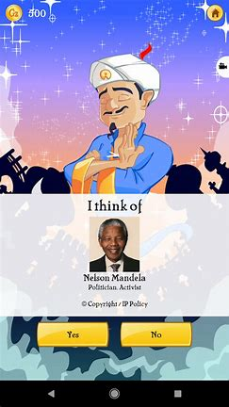
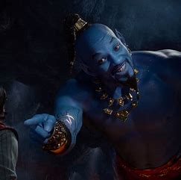
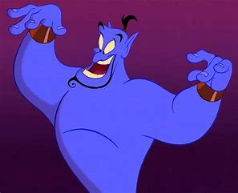
Famous Genies
4
Notes:
4

Slide 5
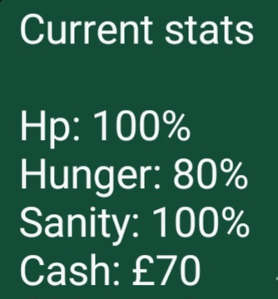
Game Mechanics
There is no inventory as the genie has given you pocket dimension space to store all your stuff
If you type stat, he will show your current stat including your hp, sanity, hunger and the available cash on you
7
Notes:
7

Slide 6
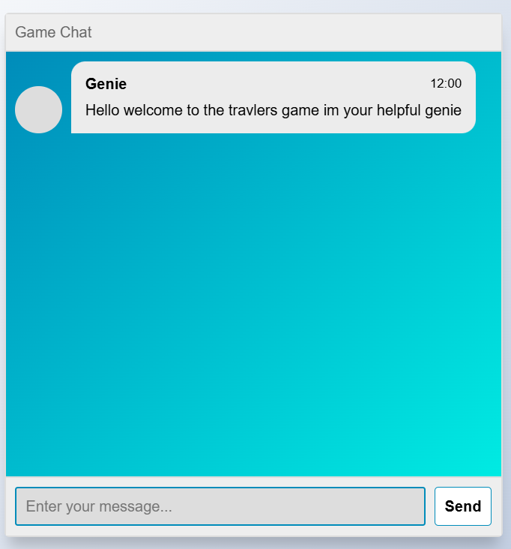
User Interface
This how the user interface would like making it seem like you're chatting with him but it’s a web browser
‹#›

